Slide 1
On-line Construction of Suffix Trees
Esko Ukkonen
Algorithmica, Vol. 14, No. 3, pp. 249-260, 1995
Presenter: Yung-Hsing Peng
Date: Mar. 29, 2007

Slide 2
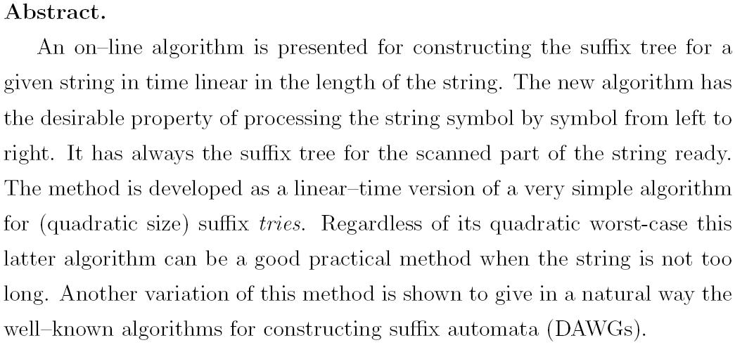

Slide 3
Uncompressed Suffix Tree
T = agagt
a
t
g
S₁ | agagt
S₂ | gagt
S₃ | agt
S₄ | gt
S₅ | t
5
g
a
t
4
a
t
g
3
g
t
2
t
1
Takes O(n²) space

Slide 4
Compressed Suffix Tree
T = agagt
ag
t
g
S₁ | agagt
S₂ | gagt
S₃ | agt
S₄ | gt
S₅ | t
5
agt
t
agt
t
1
3
2
4
(1,2)
(5,5)
(2,2)
a | g | a | g | t
1 | 2 | 3 | 4 | 5
5
(3,5)
(5,5)
(3,5)
(5,5)
1
3
2
4
Compressed suffix tree only takes O(n) space!

Slide 5
Explicit and Implicit Suffix Tree
T = agag
ag
g
Explicit
S₁ | agag
S₂ | gag
S₃ | ag
S₄ | g
ag
ag
1
3
2
4
agag
gag
Implicit
A suffix tree is explicit if it contains each leaf node for each suffix. Otherwise, we call it an implicit suffix tree.
Theorem: If T ends with a unique character, then the suffix tree of T must be explicit.

Slide 6
Ukkonen’s Result
The implicit suffix tree of T can be constructed using an on-line algorithm in O(n) time.
To obtain the explicit suffix tree of T using Ukkonen’s algorithm, we can add a unique symbol “$” as the end of T.
→ Next we first show the on-line construction of suffix tree for T = agagt.

Slide 7
Straightforward On-line Construction (1/2)
start
a
ag
ag
aga
a
ag
ag
g
aga
g
ADD root
FIND root
ADD ‘a’
FIND ‘a’
ADD ‘g’
FIND root
ADD ‘g’
FIND ‘ag’
ADD ‘a’
aga
aga
agag
agag
agag
aga
ga
aga
ga
agag
ga
agag
gag
agag
gag
FIND ‘g’
ADD ‘a’
FIND root
ADD ‘a’
Exist!
FIND ‘aga’
ADD ‘g’
FIND ‘ga’
ADD ‘g’
FIND ‘a’
ADD ‘g’
Exist!

Slide 8
Straightforward On-line Construction (2/2)
agag
agagt
agagt
agagt
agag
gag
agagt
gag
agagt
gagt
ag
gagt
agt
t
FIND root
ADD ‘g’
Exist!
FIND ‘agag’
ADD ‘t’
FIND ‘gag’
ADD ‘t’
FIND ‘ag’
ADD ‘t’
Split!
agagt
agagt
ag
g
ag
t
g
Finish!
agt
t
agt
t
agt
t
agt
t
FIND ‘g’
ADD ‘t’
Split!
FIND root
ADD ‘t’

Slide 9
Improvement with Suffix Links
The straightforward implementation takes O(n³) time.
Bottleneck: The operation “FIND” takes O(Dep) time, where Dep denotes the depth of the suffix tree. In the worst case it takes O(n) time, while on average it takes O(logn) time.
By using suffix links, the operation “FIND” takes only constant time on average. → O(n²) time on-line algorithm.

Slide 10
Suffix Links
S_{i} = xAB
S_{j} = xAC
S_{i+1} = AB
S_{j+1} = AC
A, B, C are strings with B[0]≠ C[0]
xA
A
The suffix link sl(xA) of the internal node xA brings you to the internal node of A.
If the internal node of xA exists, then the internal node of A must also exist.
(Do you know why?)
suffix link
B
C
B
C
i
j
i+1
j+1
Note: Following the suffix link brings you up at most one level in the tree.
No suffix links reside in leaf nodes.
Each internal node has its own suffix link.

Slide 11
Rule for Adding Suffix Links
The suffix link of the root links to the root itself.
If a splitting occurs after locating “xA”, set the newly added internal node v to the “standby” state.
After locating “A” in the next iteration, set the suffix link of v to its destination v’.
→The destination v’ is either (1) a newly added internal node, or (2) an internal node that already exists.
If a string Y is located at an edge or a standby internal node, then we have sl(Y)=sl(P(Y)), where P(Y) denotes the parent of Y.

Slide 12
On-line Construction with Suffix Link (1/2)
start
a
ag
ag
1st leaf
a
1st leaf
ag
1st leaf
ag
g
Insert root
ADD sl(root)
LOCATE root
ADD ‘a’
Set 1st leaf
LOCATE 1st leaf
ADD ‘g’
GOTO sl(a)
LOCATE ‘nothing’
ADD ‘g’
aga
aga
aga
………….
1st leaf
aga
g
1st leaf
aga
ga
1st leaf
aga
ga
Here we omit the boring parts and jump to agagt
LOCATE 1st leaf
ADD ‘a’
GOTO sl(ag)
LOCATE ‘g’
ADD ‘a’
GOTO sl(g)
LOCATE ‘nothing’
ADD ‘a’
Exist!

Slide 13
Straightforward On-line Construction (2/2)
agagt
agagt
agagt
Standby
GOTO sl(gag)
LOCATE ‘ag’
ADD ‘t’
Split!
SET Standby
ag
1st leaf
agagt
gag
1st leaf
agagt
gagt
gagt
1st leaf
agt
t
LOCATE 1st leaf
ADD ‘t’
GOTO sl(agag)
LOCATE ‘gag’
ADD ‘t’
agagt
agagt
GOTO sl(ag)
LOCATE ‘g’
ADD ‘t’
Split!
ADD new link
SET Standby
GOTO sl(g)
LOCATE ‘nothing’
ADD ‘t’
ADD new link
ag
g
Standby
ag
t
g
agt
t
agt
t
agt
t
agt
t
Finish!

Slide 14
Algorithm with Suffix Links
S = “suffix tree of T[1]”, y=“path end for T[1] in S” /*Set 1st leaf*/
For i = 1 to n-1 do
begin {Convert S to Suffix tree of T[1..i+1]}
u = null
For “j = 1 to i+1” do
begin
/*GOTO+LOCATE*/
x= (j=1) ? y : “Locate the end of path for T[j…i] using x”
z= “Extend the path to T[j..i+1], set new node v”
/*Check if there exists a standby node*/
if u != null then
“add suffix link from u to (v=null?x:v)”
endif
u = v
end
end

Slide 15
Analysis for the Algorithm with Suffix Links
The operation “FIND” is now replaced by “GOTO” and “LOCATE”.
Case (1): T[j, i] ends at an internal node
→ It takes constant time to locate T[j+1,i] by following the suffix link sl(T[j, i]). (GOTO only)
Case (2): T[j, i] ends at an edge
→ It takes O(C) time to locate T[j+1, i] by first following the suffix link sl(P(T[j, i]), then traverse down C nodes. (GOTO + LOCATE)

Slide 16
Amortizing for Suffix Links
Note that the operation GOTO only takes you up by 1 or 0 levels in the suffix tree.
→ In each i iteration, the cost O(C₁)+O(C₂)+…+O(C_{i}) is bounded by O(Dep), since the cost C_{j} brings you down by C_{j} levels.
Therefore, we have derived an algorithm that takes O(n²) time in the worst case.
→ We need the last trick to obtain the O(n) time algorithm.

Slide 17
The Trick of Infinity
agag
agagt
agagt
agagt
agag
gag
agagt
gag
agagt
gagt
ag
gagt
agt
t
ADD ‘t’
ADD ‘t’
Let the edges to leaf nodes be of the form (k, ∞)
ADD ‘t’
Split!
(1,2)
(1,∞)
(2,∞)
(1,∞)
(2,∞)
(1,∞)
(2,∞)
(2,∞)
(3,∞)
(5,∞)
If an ADD operation only adds a character to a leaf node → Do nothing!

Slide 18
Final Observation
After locating T[j, i], there are three cases for adding T[i+1].
Case 1: T[j, i+1] ends at a leaf node (Do nothing!)
→ T[j, i+2], T[j, i+3]…,T[j, n] all end at the same leaf node → locate T[j+1, i+1]
Case 2: T[j, i+1] already exists in S (Do nothing!)
→ T[j+1, i+1], T[j+2, i+1]…,T[i+1, i+1] also exist in S → locate T[j, i+2]
Case 3: T[j, i+1] causes a split (Add a new node)
T[j, i+1] now ends at a leaf node. (Back to Case 1) → locate T[j+1, i+1]
Case 1 & 3 can be done by following suffix links
Case 2 means you can proceed with T[i+2]

Slide 19
Final Algorithm
S = “suffix tree of T[1..2]”, j=2, x=“path end for T[1..2] in T” //Set 1st leaf
for (i=2; i<n; i++)
{
/* x = end of path T[j-1 .. i] AND x is a leaf of S */
z = x; z.Length = z.Length+1 /* z = path T[j-1 .. i+1] */
u = null
for (; j <= i+1; j++) /* j will only increase */
{
x= “Locate the end of path for T[j…i] using x = path T[j-1 .. i]”
z1=z; z= “Extend the path x to T[j..i+1], set new node v”
/* x = end of path T[j .. i] */
/* z = end of path T[j .. i+1]; z1 = end of path T[j-1 .. i+1] */
if u != null then “add suffix link from u to (v=null?x:v)”
u= v
if “Extension was Case-2” break; //Check for Case-2
}
x= (j=i+2 ? z : z1) /* x = end of path T[j-1 .. i+1] */
}

Slide 20
Amortizing for Final Algorithm
In this algorithm, let C₁+C₂+…+C_{n} be the sum of costs for traversing down the suffix tree in the i-loop.
When adding each T[i], it only increases the depth of suffix tree by up to one level. Therefore, we have C₁+C₂+…+C_{n} ≤ Dep+2n. (Recall the amortizing for suffix links)
→ We have obtained the on-line O(n) time algorithm.

Slide 21
Alphabetical Crisis (1/2)
Let ∑ be the alphabet used in the given string.
In our previous example, we have ∑ = {a, g, t}={97, 103, 116}.
→ If the size of alphabet is not negligible, Ukkonen’s algorithms takes at least O(wn) time, with O(w) be the cost for determining the correct outgoing edge.
What can you do to handle these edges?
→ Different approach yields different w.
σ₁
σ|∑|
σ₂
σ₃
……

Slide 22
Alphabetical Crisis (2/2)
In each internal node, edges can be stored in several ways
(1)Sorted array: → O(w) = O(log|∑|)
It takes O(|∑|n) time and O(n) space to construct the suffix tree, since each new edge is added in O(|∑|) time.
(2)Link list: → O(w) = O(|∑|)
It takes O(|∑|n) time and O(n) space to construct the suffix tree.
(3)Balanced search tree: → O(w) = O(log|∑|)
It takes O(nlog|∑|) and O(n) space to construct the suffix tree.
(4)Hashing: → O(w) = O(1)
It takes O(n) time and O(n) space to construct the suffix tree.

Slide 23
Sorting with Suffix Tree
Let R be a string of n real numbers r₁, r₂, r₃…, r_{n.}
Let S_{R} be the suffix tree of R.
The order of leaf nodes traversed by the lexical DFS in S_{R} yields the sorted sequence of R.
Sorting reduces to Suffix Tree Construction.
Theorem: It takes Ω(nlogn) time to construct a suffix tree of a string over an unbounded alphabet, in which the order of characters can only be determined by comparison.
Epilogue: For the alphabet which can be sorted in O(n) time, such as the integer alphabet {1, 2, 3,…, n}, can we construct the suffix tree in O(n) time?
→ YES! Please read the following paper of Farach-Colton et al.
“On the Sorting-Complexity of Suffix Tree Construction”, Journal of the ACM, Vol. 47, No. 6, pp. 987-1011, 2000

